Slide 1
Project Phase 3: Mid-Term 2nd Presentation Project Title: Landslide Prediction And Detection Using IoT System
Submitted By: Submitted To:
Shirshak Kumar Kafle Dr. Pradeep Singh Rawat
190105032 Assistant Professor, DITU
Harsh Rai
190105029
Aditya Amgain
190105034

Slide 2
Content:
Problem Statement and introduction
Feature
Hardware
Software Required

Slide 3
Problem Statement
The landslide is one kind of serious hazards that causes life and financial losses.
It’s a serious threat to the human and damage the various poverty and surface Environment of the global.
In order to manage and reduce its damages, many efforts to monitor and alert landslides are studied and developed.
So, it’s necessary that we can find the solution in which we get information quickly and data accurately
In this phase, we are working on the Research Paper and also implementing the hardware part.

Slide 4
Continue…………
We will combine sensors like Soil moisture sensor, Accelerometer sensor and connect it with Raspberry Pi to generate data and that data will be used in our Machine Learning Algorithm to predict Landslides.
In this phase, I’m working on this presentation and also working on the Accelerometer part.
Aditya is working with Cloud services.
And Shirshak, our team leader will be working on Soil Moisture Sensor.

Slide 5
Common problem
Common problems in our project are:
Our main problem would be generating accurate data with the use of sensors, if out data is not accurate then our model would not be able to predict landslides accurately.
Our second problem would be the Machine Learning Model that we are using. It should generate accurate results with the help of our data.

Slide 6
Feature
Accelerometer
Soil Moisture sensor
IoT
Cloud Services
Machine Learning Algorithm

Slide 7
Hardware
Raspberry Pi
Accelerometer
Soil Moisture Sensor
Audrino Nano
Node Mcu
GSM
Brad Board etc…

Slide 8
Software Required
PyCharm
Audrino SDE

Slide 9
Now we are going to show our project developing phase
In this phase, We will write Research Paper and also Implement hardware part.

Slide 10
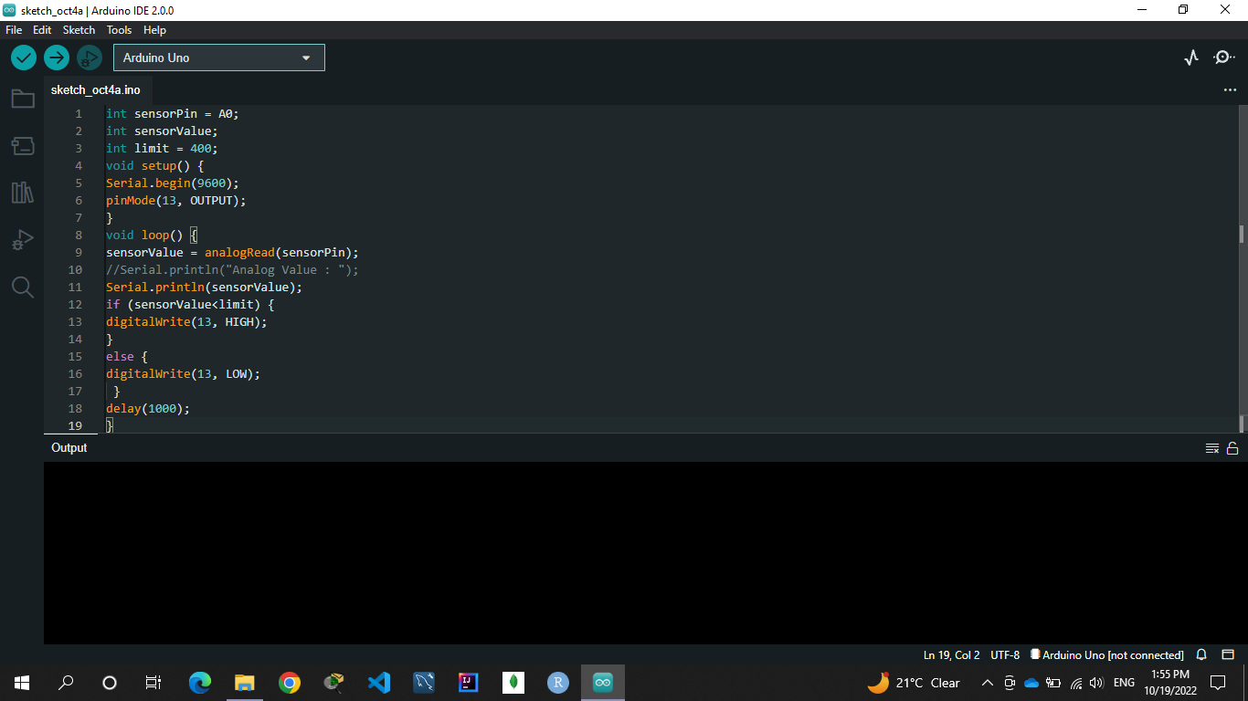
Implementation

Slide 11
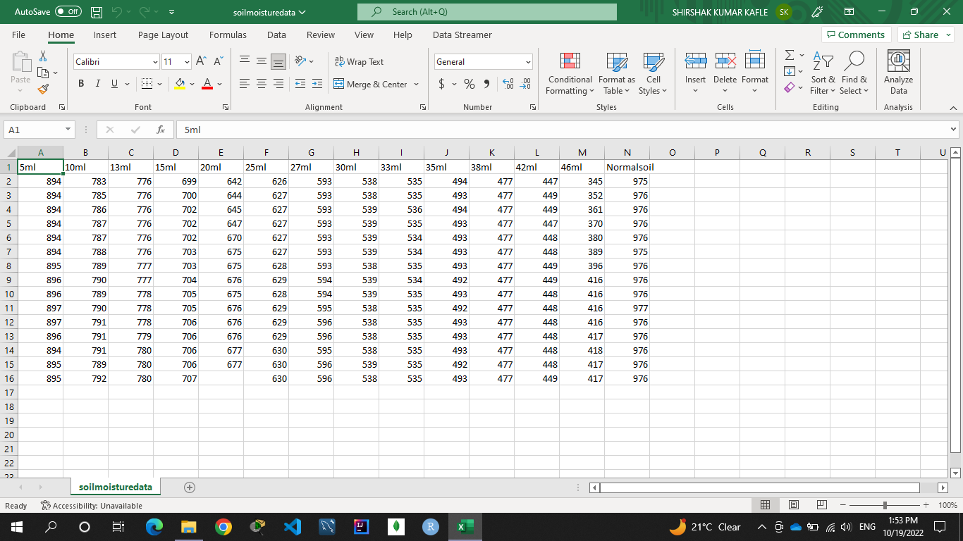

Slide 12
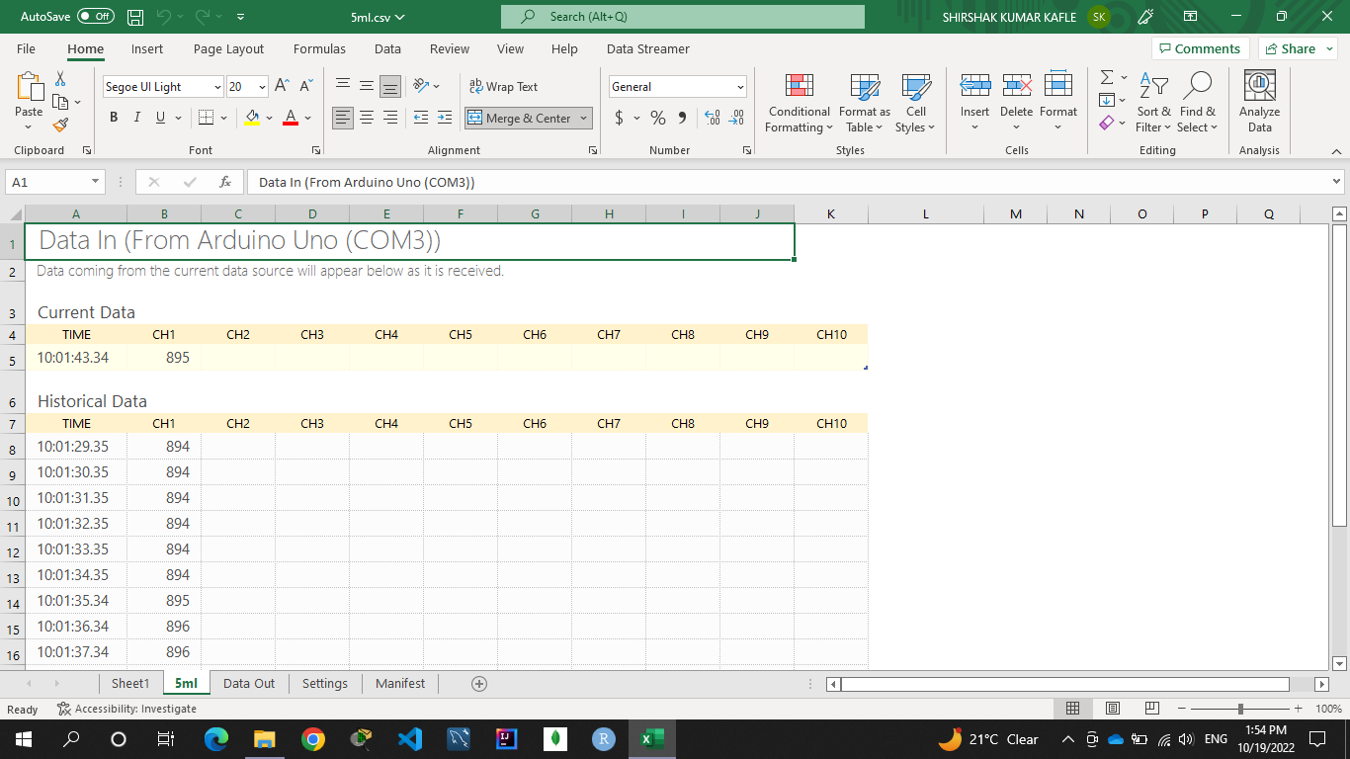

Slide 13
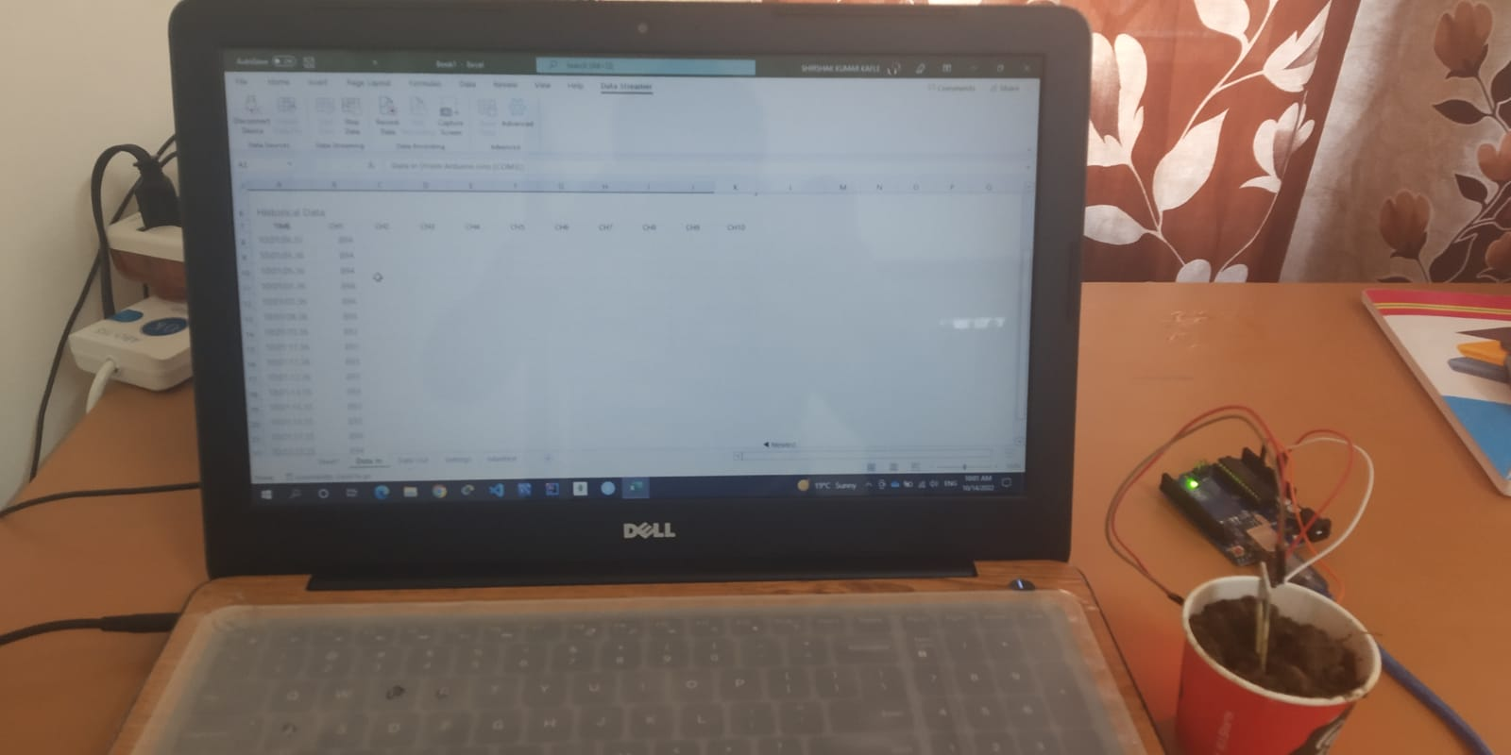

Slide 14
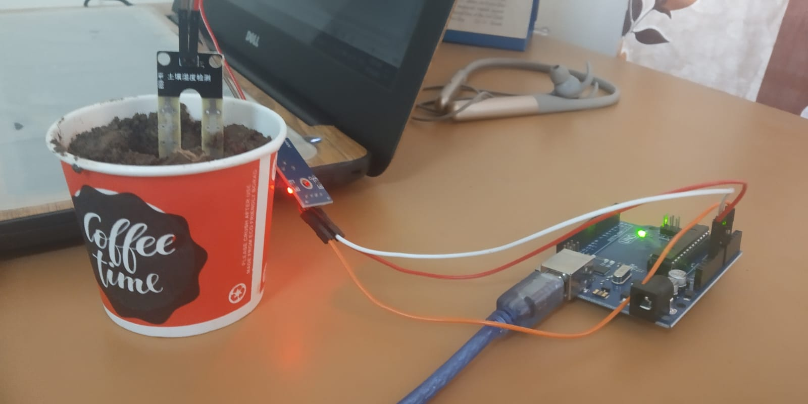

Slide 15
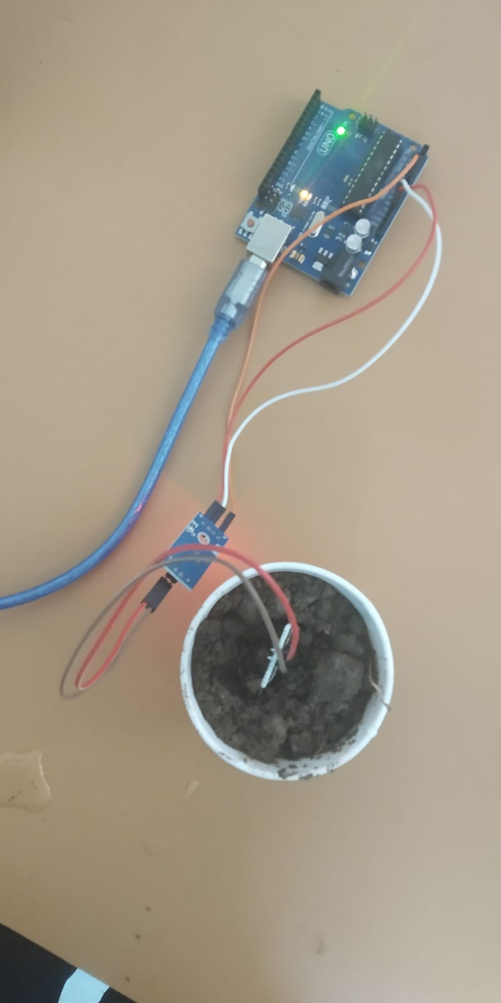

Slide 16
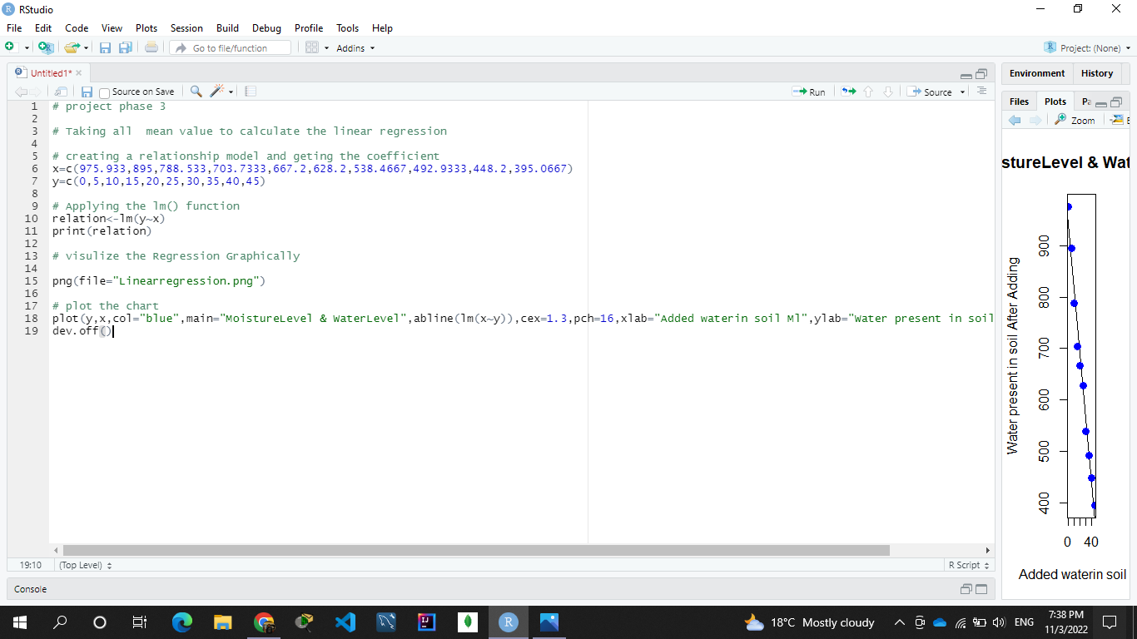
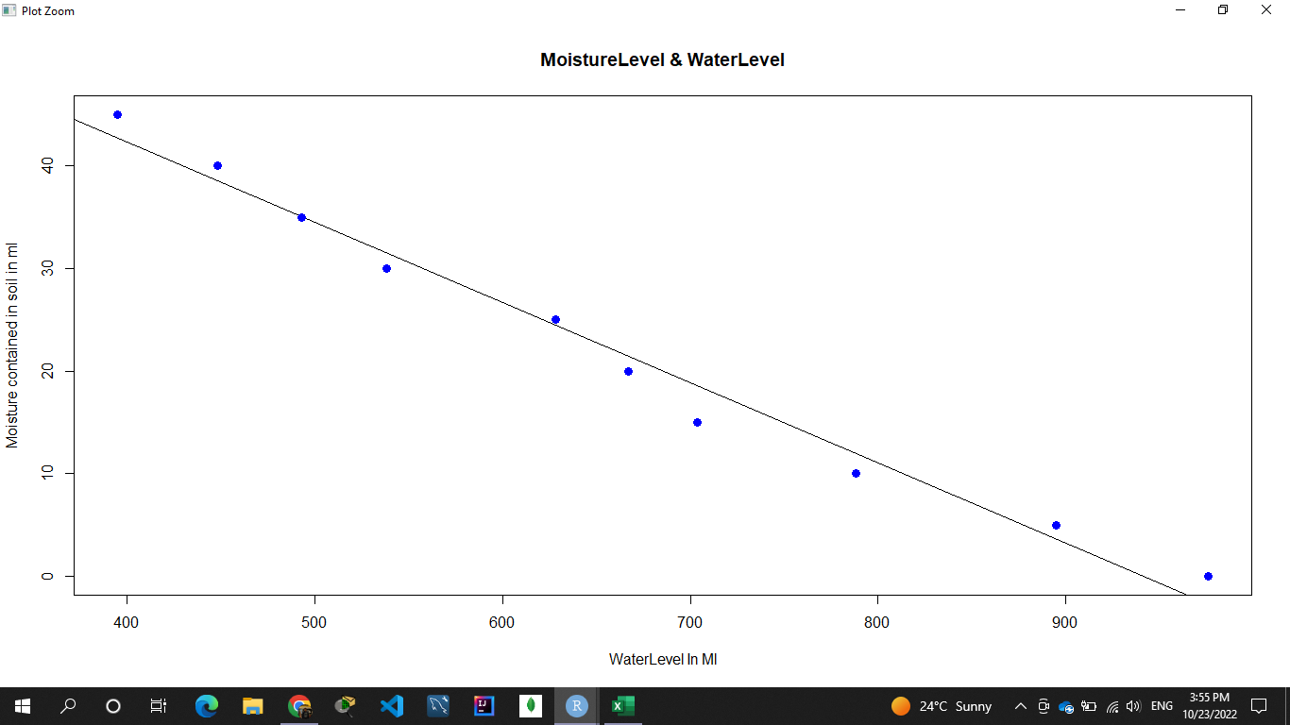
Implementing ML Algorithm

Slide 17
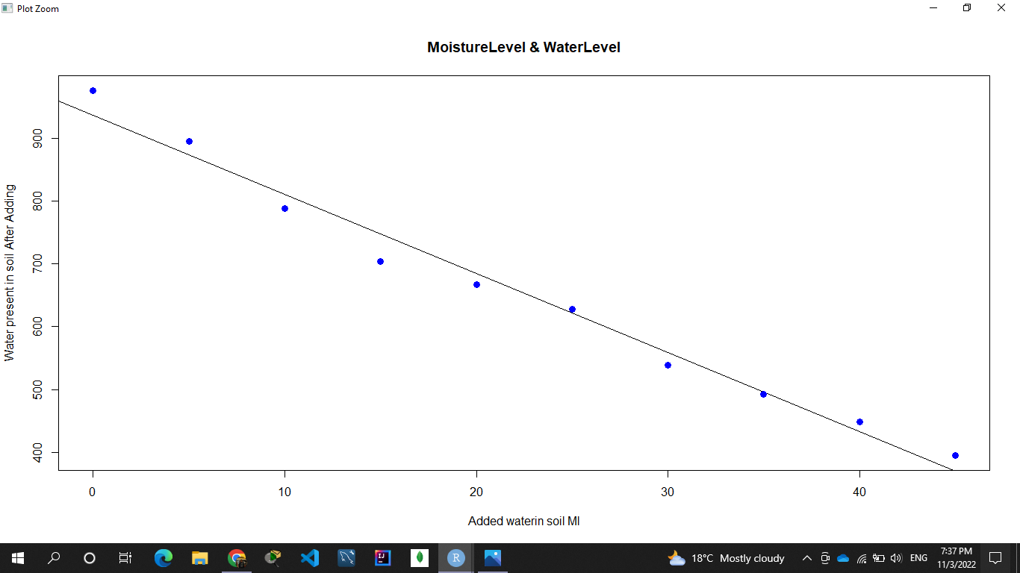

Slide 18
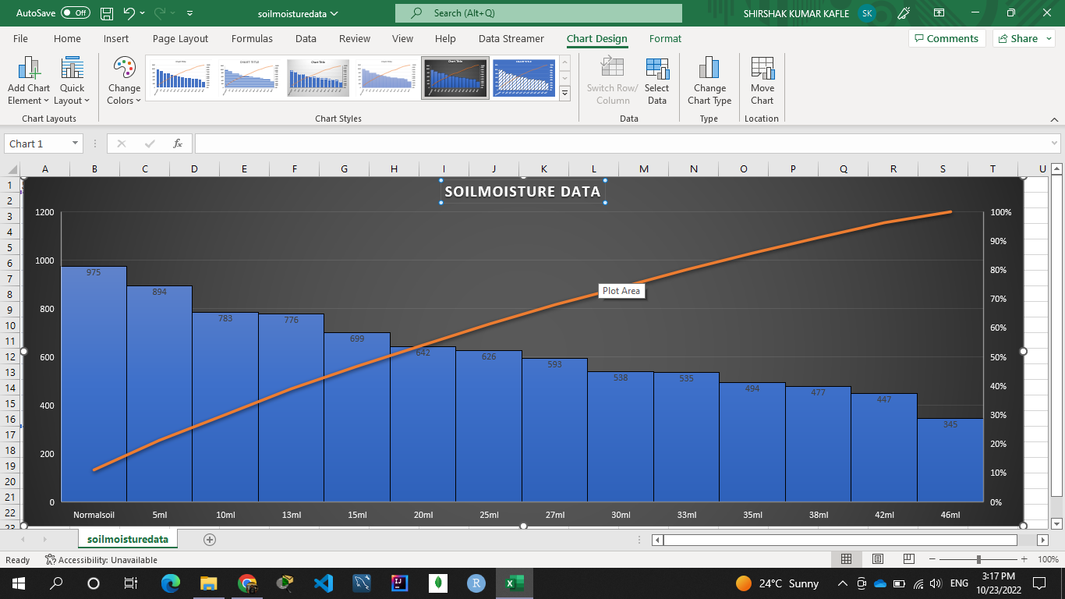
Preparing Graph From Data

Slide 19
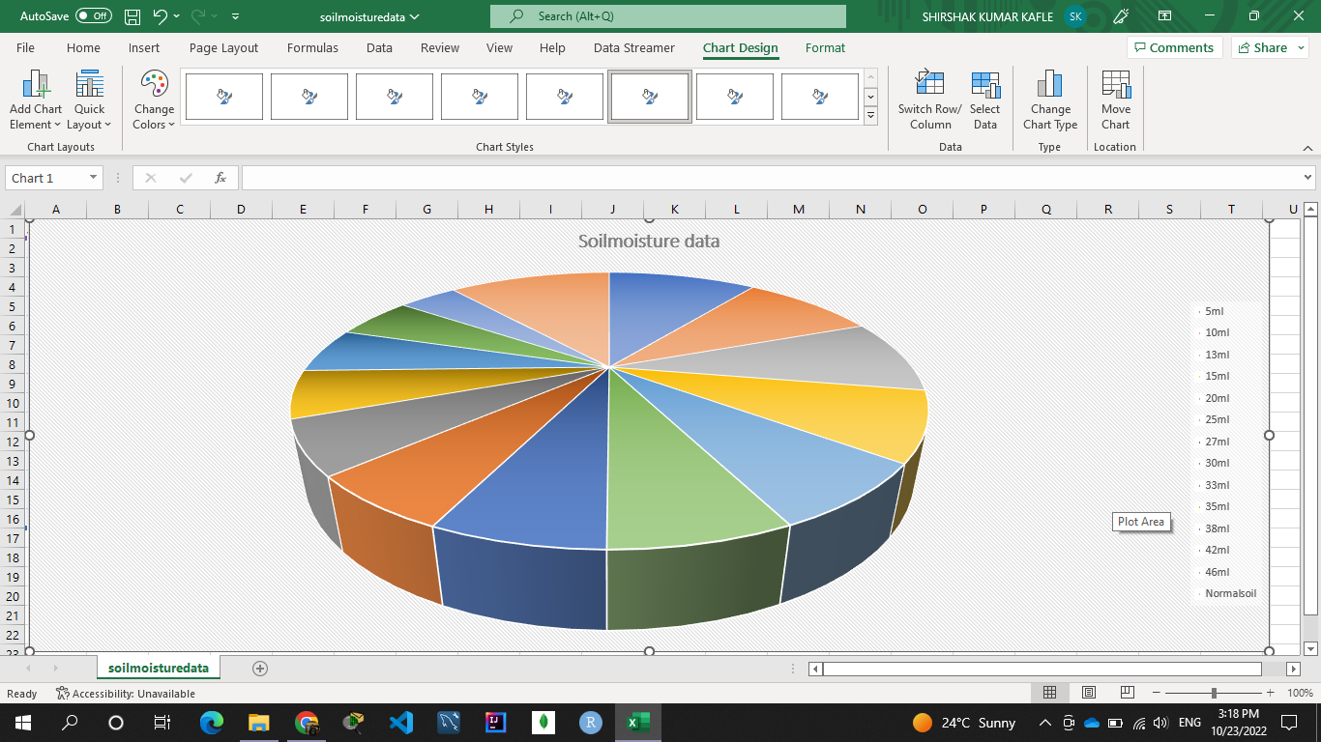

Slide 20
Thank you……………..

